Slide 1
SRI MANAKULA VINAYAGAR
ENGINEERING COLLEGE
(An Autonomous Institution)
Department of Electronics and Communication Engineering
FINGERTIP TISSUE DEFORMABILITY BASED NON-INVASIVE ANEMIA DETECTION DEVICE
Presented by
Menaga S (23UEC113)
Vasundaraa J N(23UEC209)
III-A
Department of ECE

Slide 2

Outline of the Presentation
Introduction about domain
Problem statement
Objective
Methodology/Design
Requirements
Workflow
Expected Outcome

Slide 3
Introduction about domain
• Anemia is a common health issue affecting many people • Existing methods require invasive blood tests • Finger-prick tests cause pain and infection risk • Laboratory testing is time-consuming and costly • Rural areas lack quick anemia detection facilities • Non-invasive screening is highly needed • Portable and low-cost healthcare solutions are important • Embedded and sensor-based systems enable real-time monitoring.

Slide 4
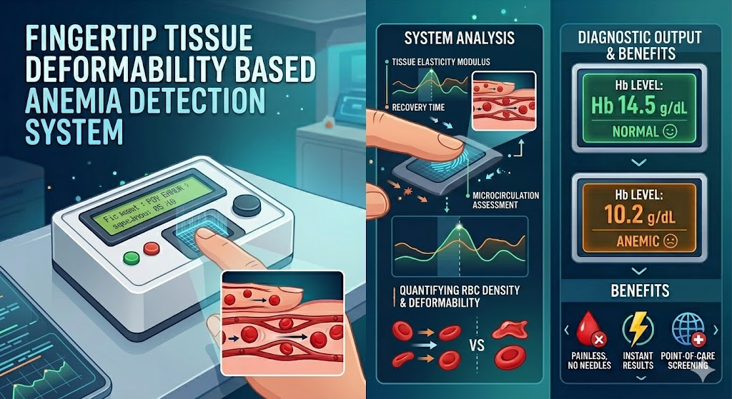
Problem Statement
• Finger-prick tests cause pain and infection risk • Hospital CBC tests are costly and time-consuming • No affordable portable devices available under ₹1000 • Rural PHCs lack instant anemia screening tools • High prevalence of anemia among pregnant women (NFHS-5) • Traditional methods depend on laboratory equipment

Slide 5
Objective
• To develop a non-invasive system for anemia detection • To measure physiological parameters like BPM and SpO₂ • To incorporate load sensor for controlled pressure measurement • To design an Arduino-based embedded system for data processing • To display real-time results using LCD • To provide alert indication using LED and buzzer • To create a low-cost and portable healthcare device

Slide 6
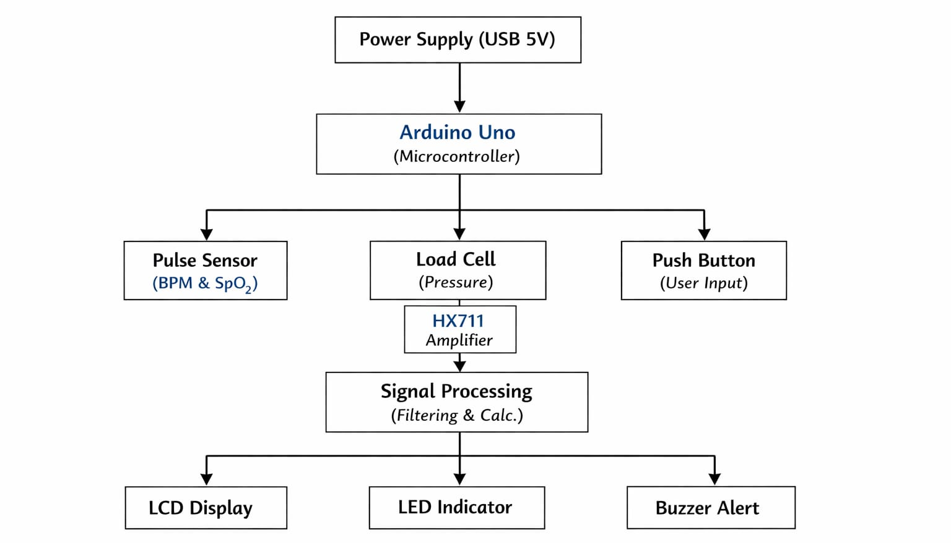
Methodology / Design

Slide 7
Methodology / Design
• Pulse sensor measures BPM and SpO₂ using sensor • Pulse sensor measures applied finger pressure • HX711 converts analog signal to digital data • Arduino processes data with filtering • Baseline and pressure signals are compared
• Detection: ▪ Normal: Stable value ▪ Anemia: High variation
Example: Sp02= 30, BPM= 40,Load cell = below 40 → Variation → Anemia detected
• LCD displays results in real time • LED & buzzer give alert for abnormal values • Low-cost, portable, non-invasive system

Slide 8

HARDWARE REQUIREMENT
• Arduino Uno microcontroller • Pulse sensor (BPM & SpO₂ measurement) • 5kg Load Cell sensor • HX711 amplifier module • 16×2 LCD display (I2C) • Buzzer for alerts • LED indicators
Requirements
SOFTWARE REQUIREMENT
• Arduino IDE
• HX711 library
• LiquidCrystal I2C library
• Embedded C programming

Slide 9
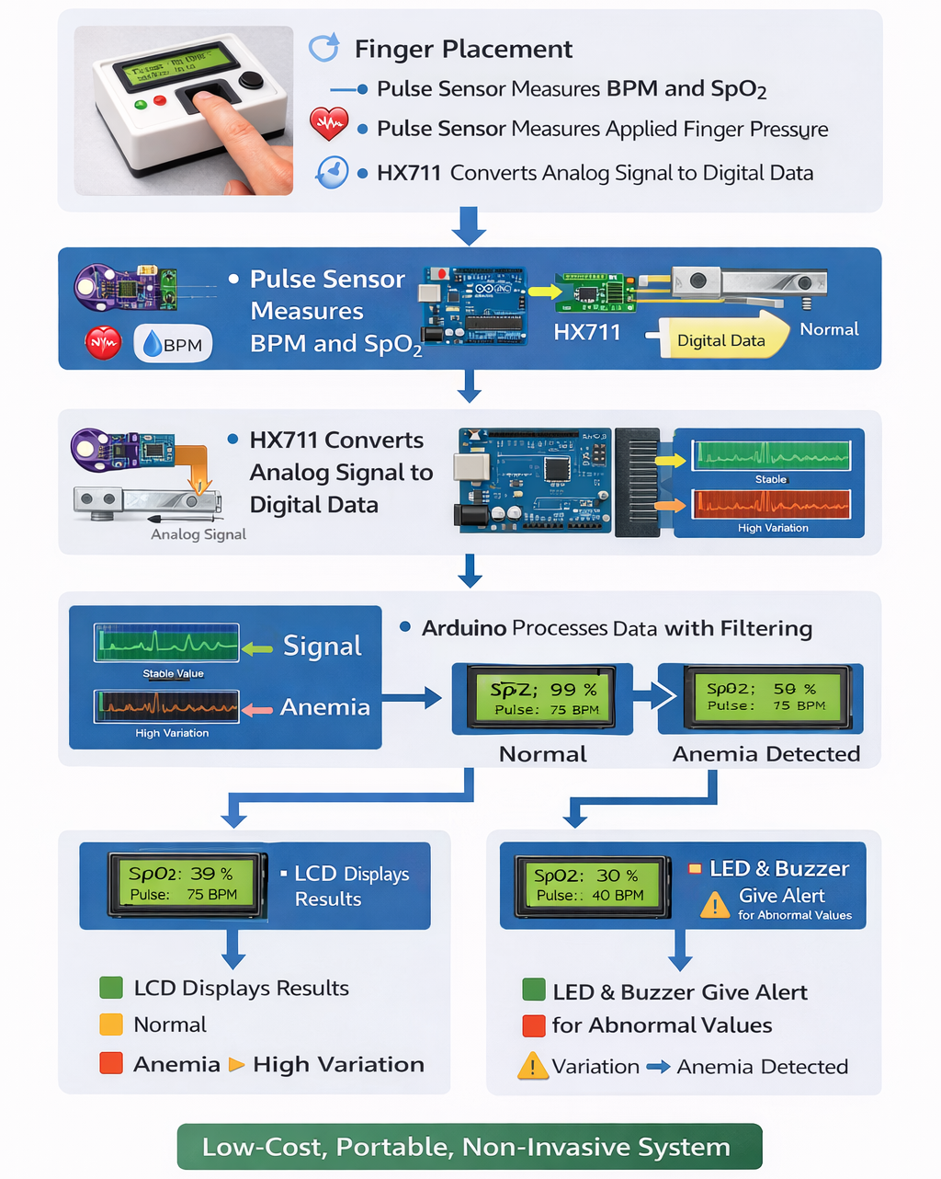
Work flow of your mini project

Slide 10
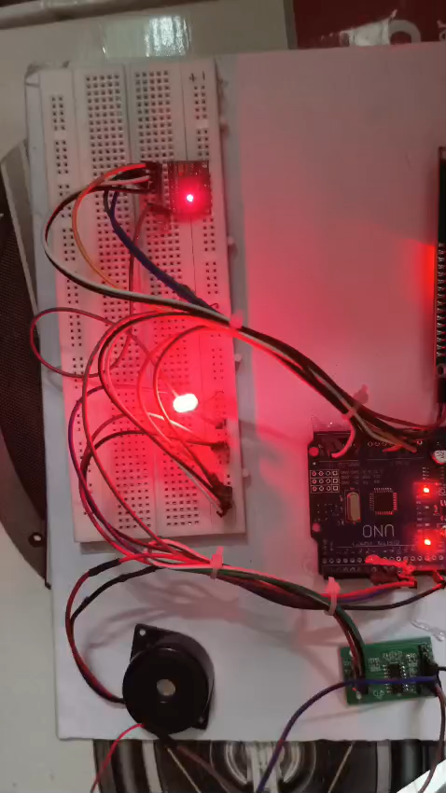
Working of the project

Slide 11
Expected Outcome
• Accurate measurement of BPM and SpO₂ values • Reliable detection of applied finger pressure using load cell • Stable and noise-free signal processing • Real-time display of results on LCD • Identification of normal and abnormal conditions • Alert indication using LED and buzzer for abnormal readings • Improved measurement accuracy using combined optical and pressure sensing • Low-cost, portable, and easy-to-use system • Useful for preliminary non-invasive anemia screenin

Slide 12
THANK YOU

